Slide 1
GALACTIC ASSAULT
Bobko Darya
https://github.com/DaryaBobko

Slide 2



USED

Slide 3
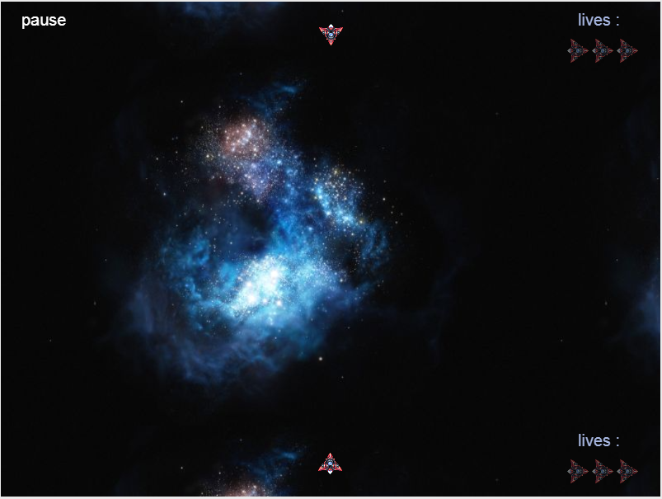
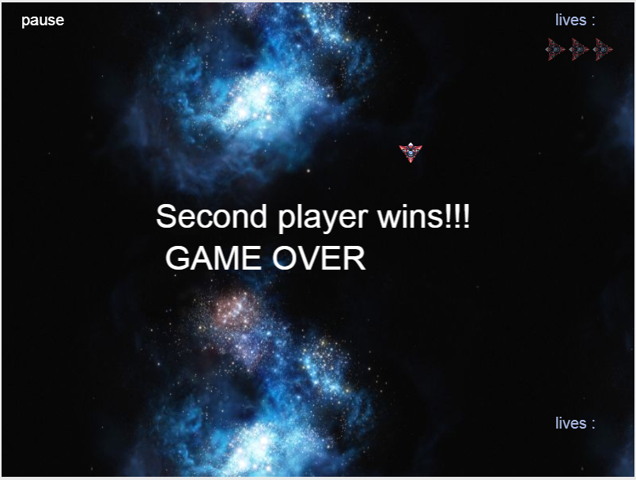
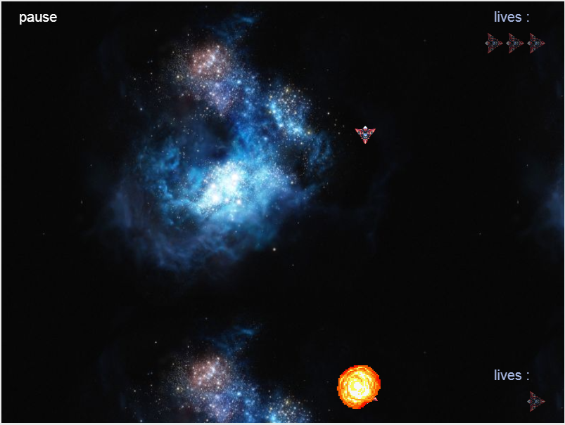
Game screenshots

Slide 4
Most challenging issues
Create game architecture

Slide 5
THANK YOU FOR ATTENTION

